Slide 1
Predicting Customer Preferences
John T. Leonard
Krishna Venkatraman
Ross Tomlin

Slide 2


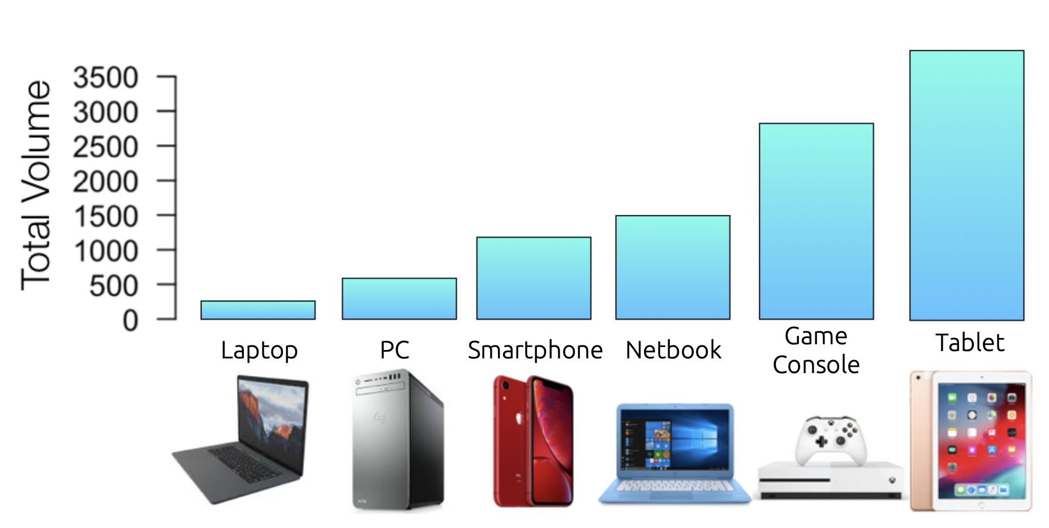
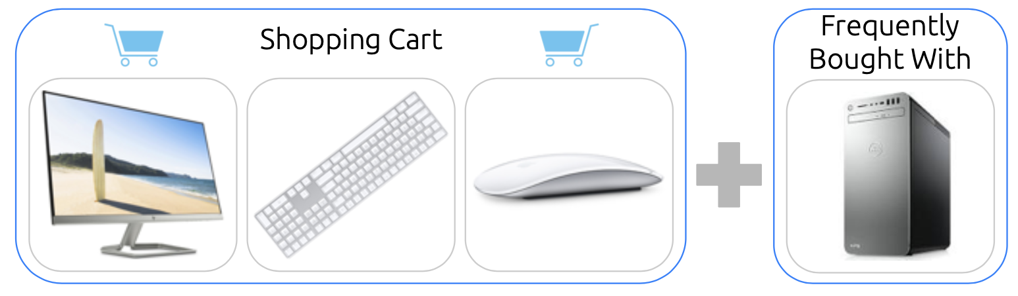


Predicting Customer Preferences | Lessons Learned: Questions Answered
Which brand do customers prefer:
Acer vs. Sony
Can we predict sales volume for new products?
Can we recommend products to customers based on product associations (recommender system)
R vs. RapidMiner?
Future Usages of Data Analytics
vs
vs

Slide 3
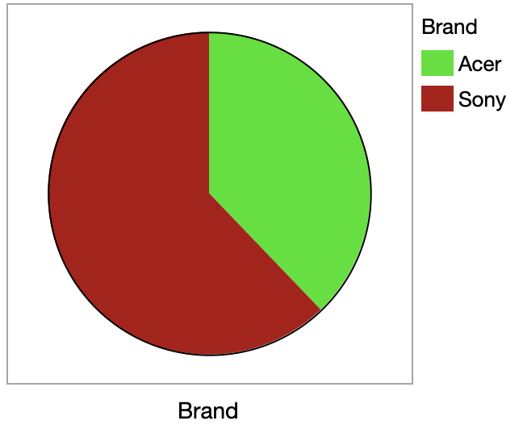
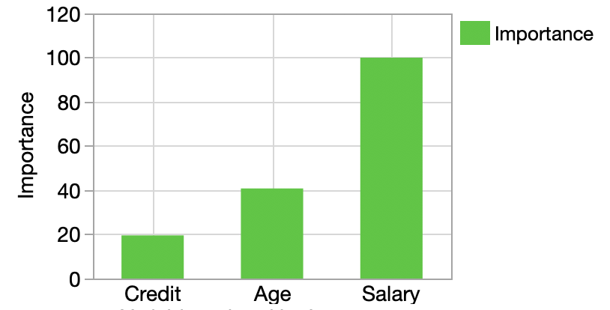
Predicting Customer Preferences | Which Brand do Customers Prefer
Which brands to customers prefer & why?
Model predicts customer brand preference with 90% accuracy
Brand preference primarily depends on 3 variables: Salary, Age, & Credit
Top 3 Most Important Variables
37%
63%

Slide 4
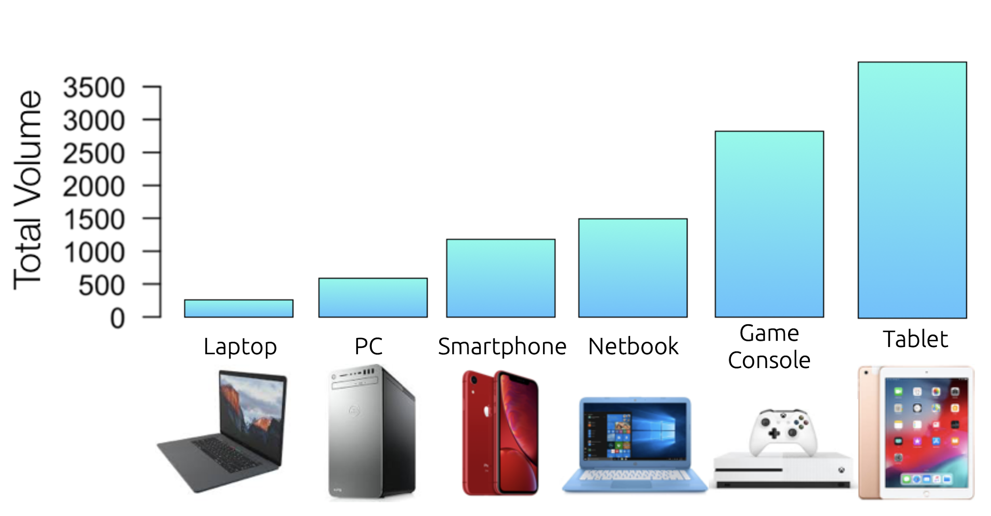
Predicting Customer Preferences | Predict Sales Volume
Can we predict sales volume for new products?
Model predicts sales volume to within +/- 1.8 sales an average for existing products
Total volume predicted for new products. Top 6 highest volume products shown below
Metric | Sales Volume Avg. Error
Model-1 | 8.5
Model-2 | 1.8
Model-3 | 2

Slide 5
Discover Product Associations
Market Basket Analysis
Measurements
Discovering relationships
Association of Customer transactions & purchased items
Uncover insights on transactional datasets
Support & Confidence
Strong & Insightful Rules
Irrelevant & Unclear Rules
Metric
# of Rules | 197
Mean Support | 0.93
Mean Confidence | 0.82
Mean Lift | 0.10
Problem Definition
Discovered Insight
Blackwell Electronics intent to acquire Electronidex
Blackwell to acquire Electronidex to amplify cross-selling & net profitability

Slide 6
R vs Rapid Miner Comparative Analysis
Description | Software programming language & software environment for statistical computing and graphics. | Software platform IDE provides an integrated environment for machine learning, data mining, text mining, predictive analytics & business analytics
Price | Open Source | Free Community Edition & Commercial Enterprise Edition
Language | R interpreted Language | GUI based IDE developed using JAVA
input/output files format | text file (ASCII,.dat), Excel spreadsheet (.csv, .delim,.DIF), Pdf, html, images,minitab, s-plus | text file (ASCII,.dat), Excel spreadsheet (.csv,.delim,.DIF), Pdf, html, images, audio, SAP
Visualization Plots | Bar chart, Pie Chart, Line, Histogram, Scatter, Conditioning Plot, Kernel Density, Quantile Quantile, Plotly, Google Visualization API | Bar chart, Pie Chart, Line, Histogram, Scatter, Bubble, Deviation, Survey plots, Density, Andrews Curves, Quartile
Performance | Best accuracy levels with missing values in datasets | Best to handle continues data type & multi class data
Structure & Development | Built-in and user-created packages & functions and in-memory data objects. Extensible using R code and Generics | Built using normal operators containing one or more sub processes & super operators relying on execution of other user defined operators. Extensible using built-in scripting operator & extensions providing new operators and new data objects

Slide 7
Applications of Data Mining
Trend/Pattern Discovery
Customer Profiling
Import, Pre-process &
Visualize data
Investigate & Assess Relationships
Discover insights & predictive analysis
Train, Test/Evaluate & Optimize models
Merchandise Planning
Sales Prediction
Cross Selling Association
Market Segmentation
Fraud Detection
Inventory Management

Slide 8
Blackwell’s Flight Journey to future selling
Analytics Driven Sales Prediction Strategy
Learn about potential customers & figure out exactly what they want
Learn how to guide them through evermore complex sales cycles
manage inventory, supply chain, forecasting demands & pricing strategies
Customer centric User Experience
Customers want differentiated experiences rather than commodity products
Blackwell to focus around positive outcomes for their customers rather than simply moving merchandise
Improvement in Customer experience with 72 % Confidence
Delivery at Speed
Ease of online payments
Increased focus on Micro Segments
Offer quick actions for mobile & website searches on — I want to go, I want to know, I want to buy, etc.
Self-Service Capability
Mobile App/ Website immaculately designed to give potential customers a raft of information on products, reviews and articles about Blackwell and easy paths to purchase, all wrapped in a cleanly designed, package
It’s as if the company’s website & Mobile Apps are its sixth product, created to make customers happy

Slide 9
Questions?

Slide 10
Appendix

Slide 11

Predicting Customer Preferences | Lessons Learned: Introduction & Overview
Questions Answered
Methods
Results
Future Opportunities

Slide 12
Predicting Customer Preferences | Lessons Learned: Questions Answered
R vs. RapidMiner?
Which brand do customers prefer:
Acer vs. Sony
Can we predict sales volume for new products?
Can we recommend products to customers based on product associations (recommender system)
vs
vs

Slide 13
Predicting Customer Preferences | Lessons Learned: Methods
3 classes of machine learning models/methods used:
Classification: Which brand do customers prefer
C5 decision tree, Random Forest
Regression: Can we predict sales for new products
support vector machine (SVM), Random forest, Gradient boosted tree
Apriori
Notes:
Ross to take stab at this

Slide 14
Predicting Customer Preferences | Lessons Learned: Methods
3 classes of machine learning models/methods used:
Classification: Which brand do customers prefer
C5 decision tree, Random Forest
Regression: Can we predict sales for new products
support vector machine (SVM), Random forest, Gradient boosted tree
Apriori
New Product Sales Volume Prediction Models (Regression)
Apriori
Brand Preference Classifier Models
Metric | Accuracy | Kappa
Decision Tree | 0.92 | 0.84
Random Forest | 0.89 | 0.87
Metric | RMSE log₁₀(Volume) | R²
SVM | 0.93 | 0.10
Random Forest | 0.28 | 0.89
Gradient Boosted Tree | 0.30 | 0.88
Metric
# of Rules | 197
Mean Support | 0.93
Mean Confidence | 0.82
Mean Lift | 0.10

Slide 15
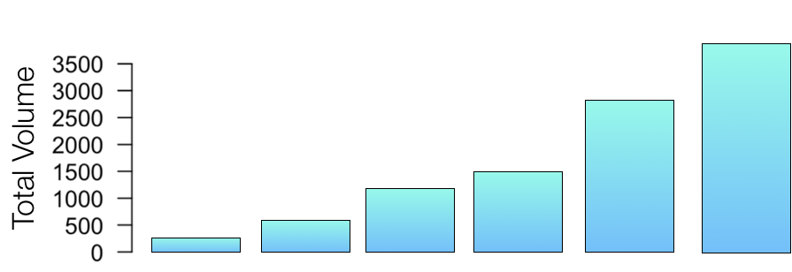






Laptop
PC
Smartphone
Netbook
Game
Console
Tablet

Slide 16
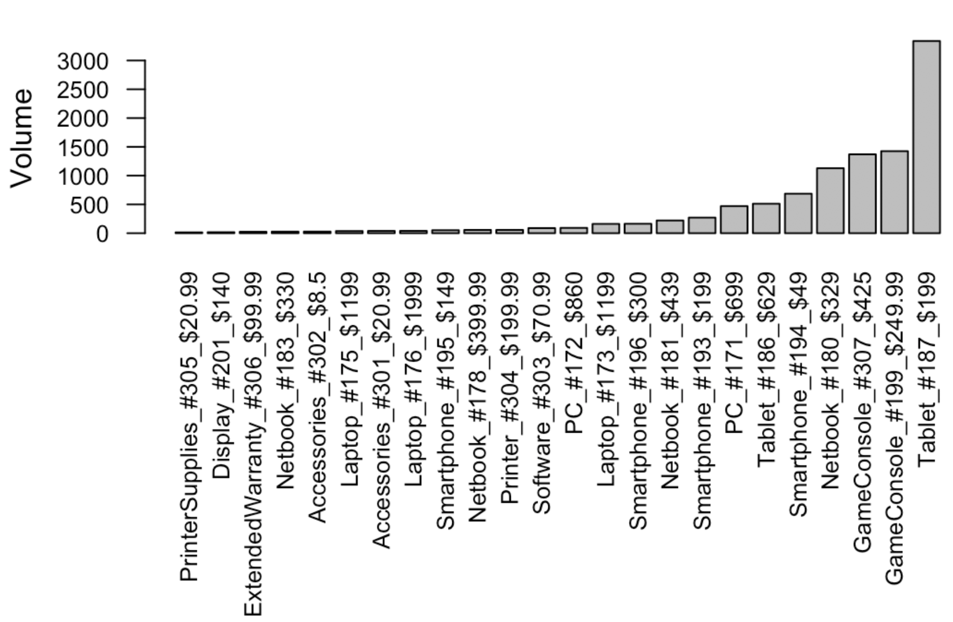

Slide 17
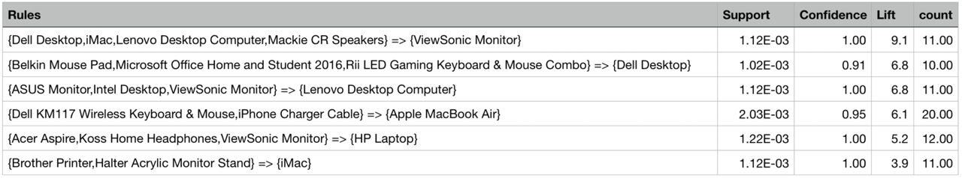




Shopping Cart
Frequently Bought With

Slide 18
Train-Test Set | Train+Test |  | Train |  | Test
Metric | Accuracy | Kappa | Accuracy | Kappa | Accuracy | Kappa
Decision Tree | 0.93 | 0.85 | 0.94 | 0.85 | 0.92 | 0.84
Random Forest | 0.97 | 0.94 | 0.99 | 0.99 | 0.89 | 0.87
Metric | RMSE log₁₀(Volume) |  | R²
Train-Test Set | Train | Test | Train | Test
SVM | 0.32 | 0.93 | 0.82 | 0.10
Random Forest | 0.09 | 0.28 | 0.98 | 0.89
Gradient Boosted Tree | 0.01 | 0.30 | 0.99 | 0.88
Metric | # Rules | Mean Support | Mean Confidence | Mean Lift
Apriori | 197 | 0.93 | 0.82 | 0.10

Slide 19
Metric | Accuracy | Kappa | Quality
Model 1 | 0.92 | 0.84 | 0.88
Model 2 | 0.89 | 0.87

Slide 20
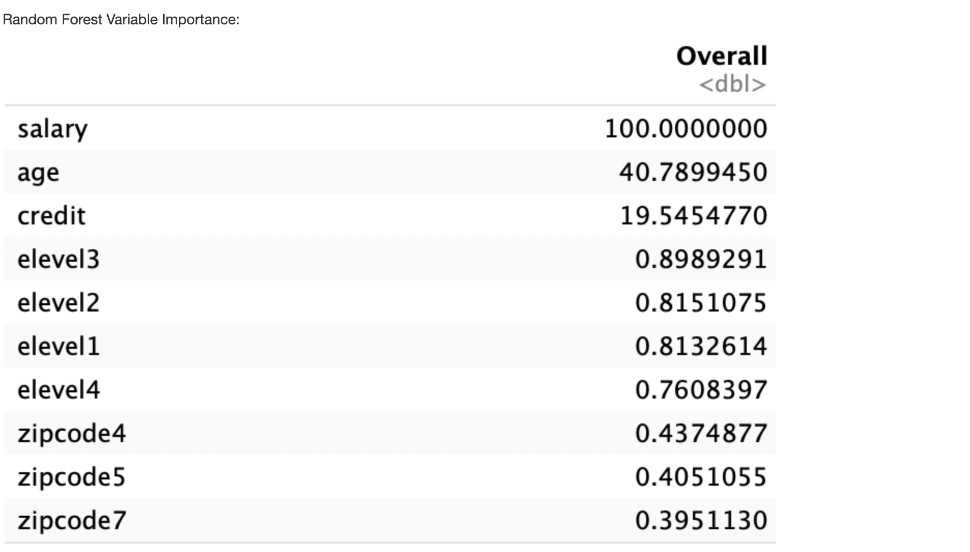
Variable Importance for Random Forest: from the R package: “For each tree, the prediction accuracy on the out-of-bag portion of the data is recorded. Then the same is done after permuting each predictor variable. The difference between the two accuracies are then averaged over all trees, and normalized by the standard error. For regression, the MSE is computed on the out-of-bag data for each tree, and then the same computed after permuting a variable. The differences are averaged and normalized by the standard error. If the standard error is equal to 0 for a variable, the division is not done.”
Top 3 Most Important Variables

Slide 21
Smartphone
Netbook
Game
Console
Tablet

Slide 22
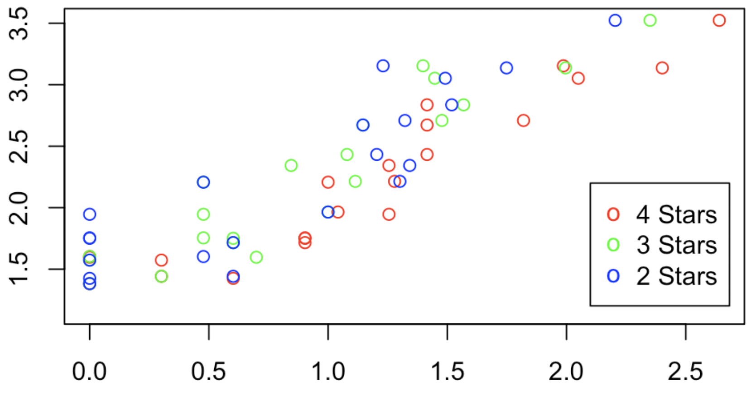
log₁₀(Volume)
log₁₀(# of reviews)

